Slide 1
Title: Tello Drone Simulation & Control – Figure-8 Path Subtitle: EE308 – Systems Simulation and Control Lab Summer 2025 Team Members:

Slide 2
Problem Definition
Objective:
Program a Tello drone to autonomously follow a predefined Figure-8 flight path and complete
as many laps as possible within a 10-minute time frame.
Project Scope:
Focus on accurate path-following and stable flight control.
The path shape is predefined as Figure-8; no specific dimensions were given.
The system must function in both simulation and real-world environments.
External positioning systems (e.g., GPS) are not allowed.
Challenges:
Maintaining flight stability throughout the figure-8 maneuvers.
Ensuring precise transitions through the curved intersections.
Consistency and reliability across both simulated and physical trials.

Slide 3
Constraints
Time Constraint:
The drone must complete as many laps as possible within a strict
10-minute flight window.
Environmental Constraints:
The drone must maintain flight stability under potential variations in indoor conditions (e.g., airflow, lighting).
Navigation is based on a black dashed line on a bright surface.
Hardware Constraints:
Limited to the Tello Drone’s built-in sensors and onboard processing.
Battery life restricts the maximum flight time and limits retries.

Slide 4
Relevant Engineering Standards
IEEE 802.11
Wi-Fi standard used for wireless communication between the drone
and the ground control system (laptop/controller).
ISO 21384-3
International standard for Unmanned Aircraft Systems (UAS),
focusing on operational procedures and flight safety.
FAA Part 107 (Reference Standard)
U.S. Federal Aviation Administration rules for small drone operations, including guidelines for safe flight and airspace compliance. (Applicable mainly in real-world outdoor use — useful for design mindset.)

Slide 5
Possible Solutions
Use a Proportional–Integral–Derivative controller to maintain the drone's alignment with the path and ensure stable flight.
Solution 1: PID Control
Pros: Simple to implement, effective for smooth/linear paths.
Cons: May struggle with sharp curves and nonlinear path transitions (like in a Figure-8).
Solution 2: Computer Vision
Utilize OpenCV to detect the black dashed line and identify possible obstacles.
Pros: Enables real-time visual tracking, adaptable to dynamic environments.
Cons: Requires good lighting and moderate computational power.
Train a reinforcement learning model to autonomously follow complex paths based on sensor feedback or vision input.
Solution 3: Machine Learning
Pros: Highly adaptive, ideal for unpredictable or nonlinear paths.
Cons: Demands large training datasets and simulation time.

Slide 6
Brainstorming
Initial Ideas:
Combine PID control with computer vision for hybrid navigation.
Use predefined path coordinates to simplify control logic.
Team Discussions:
Evaluated trade-offs between processing speed and tracking accuracy.
Considered strategies for battery optimization to maximize total flight time.
Discussed fallback behaviors in case of path loss or drift.
Final Approach Chosen:
Manual programming of the Fig
ure-8 path using DJITelloPy.
The drone follows the trajectory through predefined motion commands (forward, curve, rotate).
No vision or sensor-based navigation used.
The focus is on timing, control accuracy, and completing loops smoothly within 10 minutes.

Slide 7
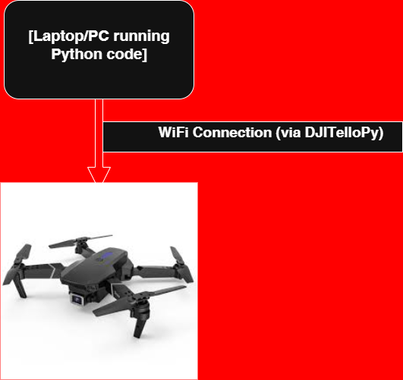
Hardware Block Diagram
System Components:
Laptop/PC: Runs the Python control code using DJITelloPy library.
Wi-Fi Connection: Sends commands from the laptop to the Tello drone.
Tello Drone: Receives motion commands and executes the Figure-8 flight path.

Slide 8
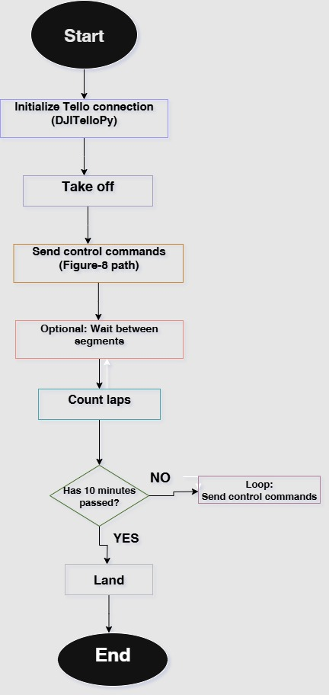
Programming Flow Chart
The flowchart illustrates the logic used in controlling the Tello drone. It starts by initializing the connection, followed by take-off. The drone then enters a loop where it follows the Figure-8 path using predefined movement commands. The loop continues until the 10-minute time limit is reached, at which point the drone lands and the program ends.

Slide 9
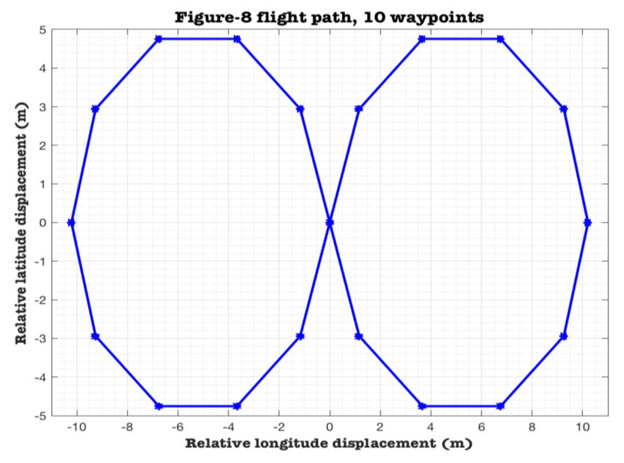
Illustration of the Drone Track Parameters
Path Shape: Figure‑8
Flight Altitude: 1 meter (adjustable for indoor safety)
Path Dimensions: Not officially provided — path is designed based on standard figure‑8 motion logic.
Loop Time Limit: 10 minutes max
Navigation: Manual movement commands; no sensors or visual markers
Control Method: Predefined movement sequences using DJITelloPy

Slide 10
Components Used in the Hardware
Components:
Ryze Tello Drone: The main flying platform, used for executing the flight path.
Laptop/PC: Runs the Python control code using the DJITelloPy library.
Wi-Fi Router / Direct Connection: Provides communication between the laptop and the drone.
Tello Battery: Powers the drone; limits flight time to around 10–12 minutes.
USB Charging Cable / Adapter: Used to recharge the drone battery between tests.

Slide 11
Project Applications
Package Delivery: Autonomous drones for last-mile delivery in remote or hard-to-reach areas.
Surveillance: Real-time monitoring for security operations and disaster response.
Land Mapping: Aerial surveying to support agriculture, urban planning, and infrastructure design.
Educational Impact: Hands-on learning experience in control systems, robotics, and computer vision.
Sustainability: Supports UN SDG 9 (Industry, Innovation & Infrastructure) by promoting drone-based technological advancement.

Slide 12
References
DJI Tello SDK Documentation (2023). Retrieved from https://www.dji.com/tello/downloads
IEEE 802.11 Standard (2020). IEEE Standards Association.
ISO 21384-3:2019. Unmanned Aircraft Systems – Part 3: Operational Procedures. International Organization for Standardization.
Federal Aviation Administration (2024). Part 107: Small UAS Operations. Retrieved from https://www.faa.gov/uas
OpenCV Documentation (2024). Retrieved from https://docs.opencv.org
Robot Operating System (ROS) (2024). Retrieved from https://www.ros.org
Russell, S., & Norvig, P. (2020). Artificial Intelligence: A Modern Approach (4th ed.). Pearson.
American University of the Middle East (AUM). Retrieved from https://www.aum.edu.kw

Slide 13
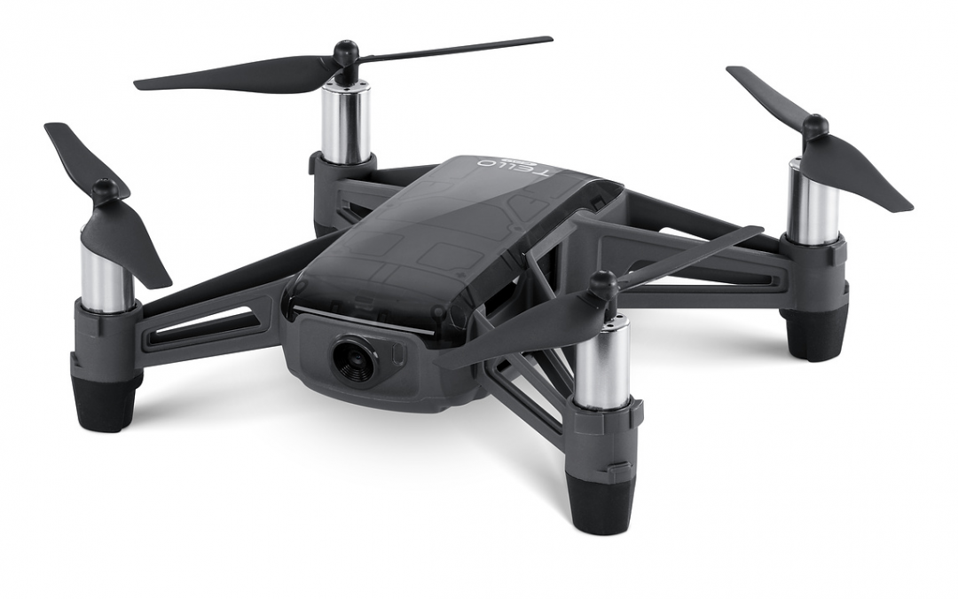
Thank You
Thank you for your time and attention.
I’m happy to answer any questions.

